Slide 1


Slide 2
This is CS50 🏈
No break today, cupcakes at end! 🧁
Submit cs50.ly/form before class starts!
Do say bye or ask questions (or ask for stress ball 🔴) after class!
(Took out winter decorations a bit early.)

Slide 4

Notes:
https://youtube.com/watch?v=Tj84DzF6_v4
https://www.dropbox.com/scl/fi/7be9cwnj707ksasbnek57/muppet_hackathon-1080p.mp4?rlkey=mc6r5w75bqm4il7g1zdr3wm8o&dl=0

Slide 5

Notes:
https://emojipedia.org/cupcake/

Slide 7
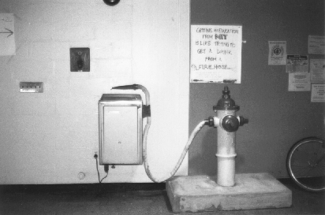
Notes:
http://hacks.mit.edu/Hacks/by_year/1991/fire_hydrant/

Slide 8
what ultimately matters in this course is not so much where you end up relative to your classmates but where
you end up relative to yourself when you began

Slide 9
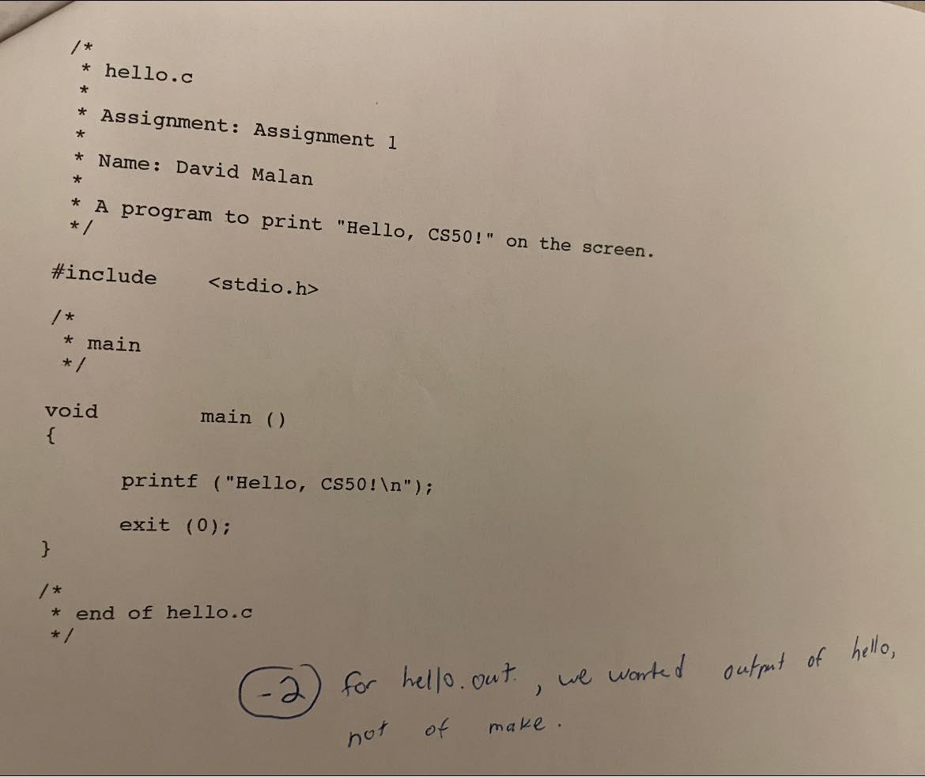

Slide 11
input →
→ output
Notes:
before process, have to represent information

Slide 12
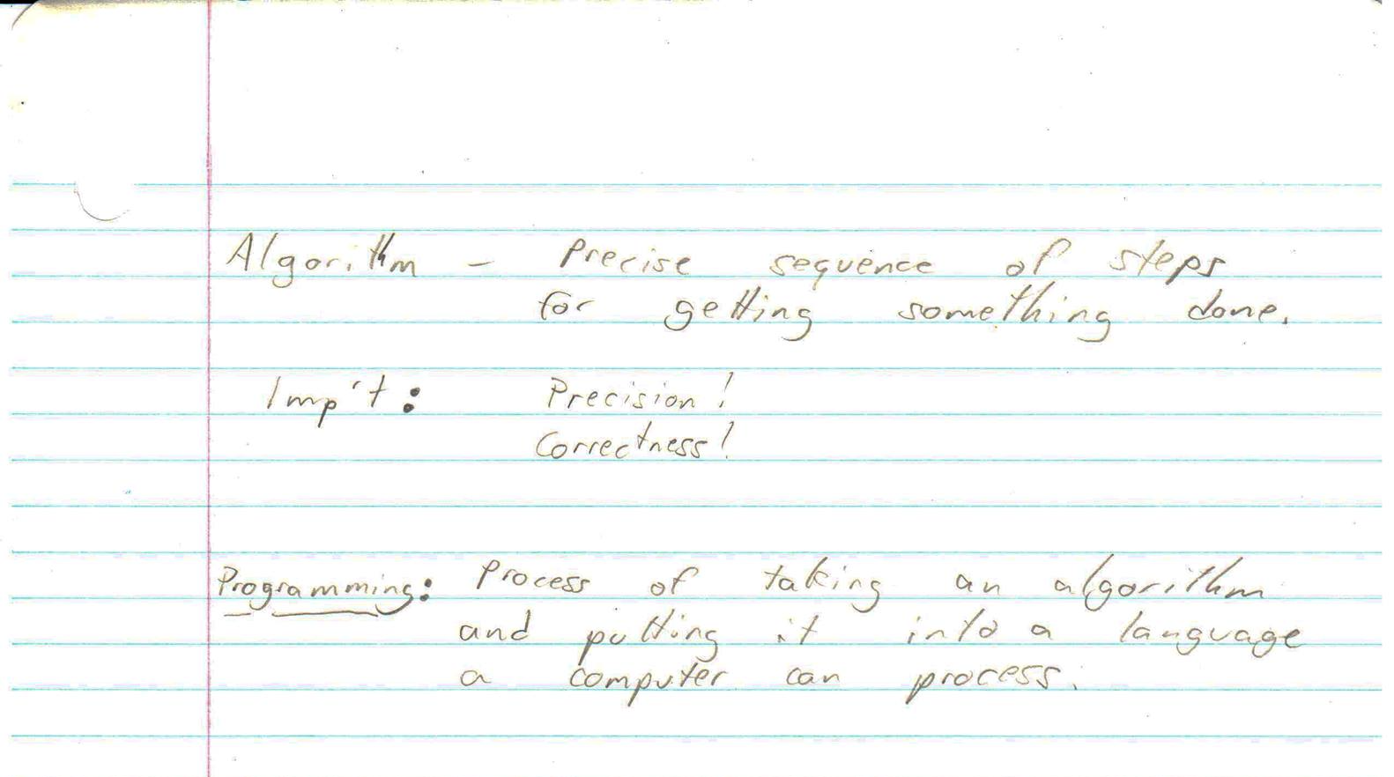

Slide 17

Notes:
Inspired by https://classic.csunplugged.org/programming-languages/.

Slide 19

Notes:
Adapted from https://hasshe.com/confused-stick-figure-clipart-5c148d2f8719620724ac7a6b/.

Slide 20
Week 0 Scratch
Week 1 C
Week 2 Arrays
Week 3 Algorithms
Week 4 Memory
Week 5 Data Structures
Week 6 Python
Week 7 SQL
Week 8 HTML, CSS, JavaScript
Week 9 Flask
Week 10 The End

Slide 21
Final Project

Slide 22
all that we ask is that you build something of interest to you, that you solve an actual problem, that you impact campus, or that you change the world

Slide 23
strive to create something that outlives this course

Slide 24
CS50 Hackathon

Slide 25
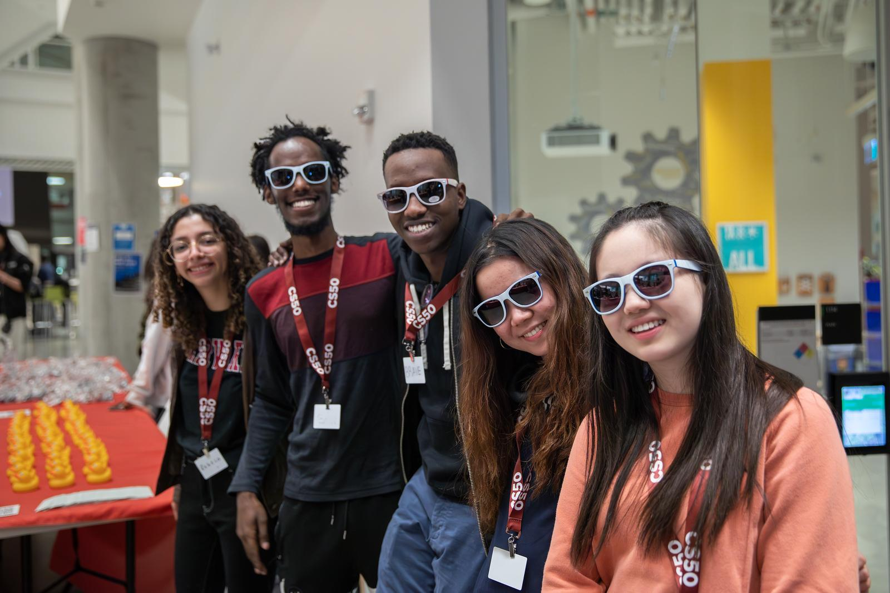

Slide 26
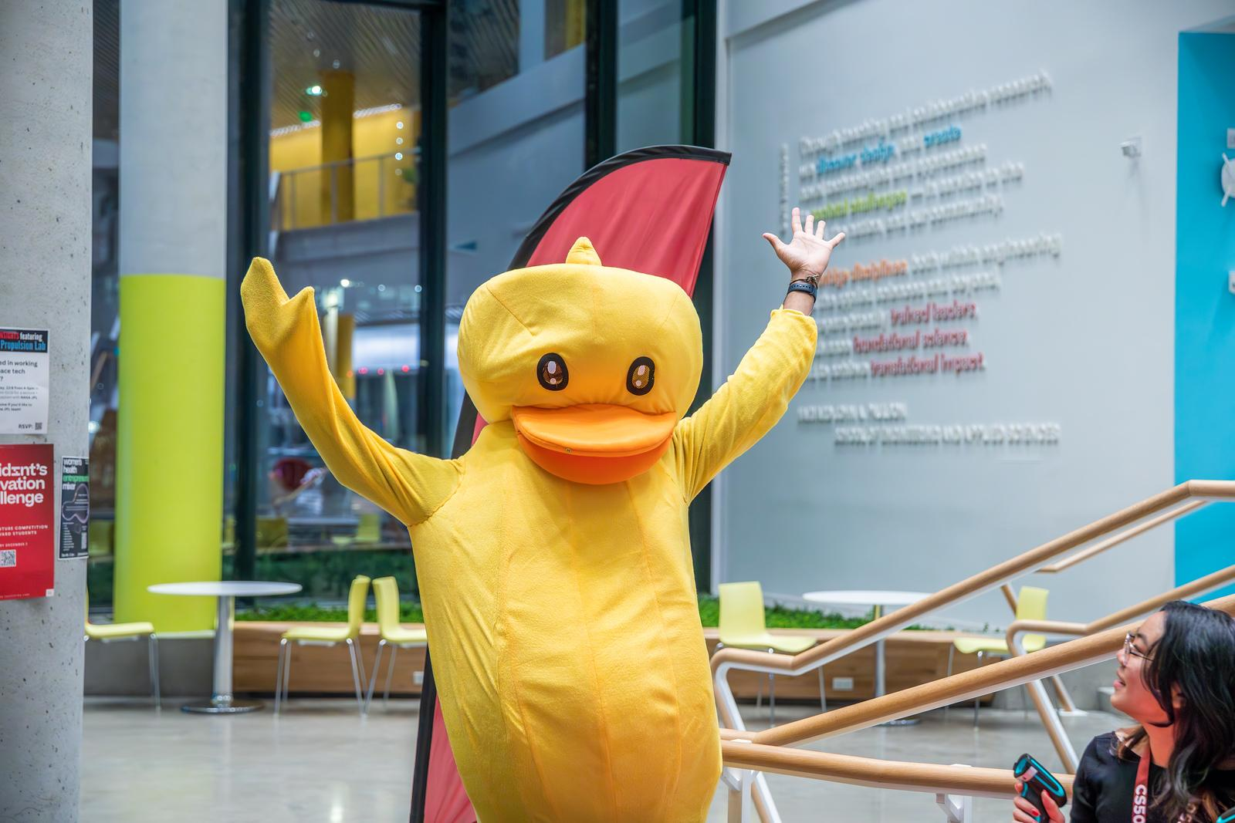

Slide 27
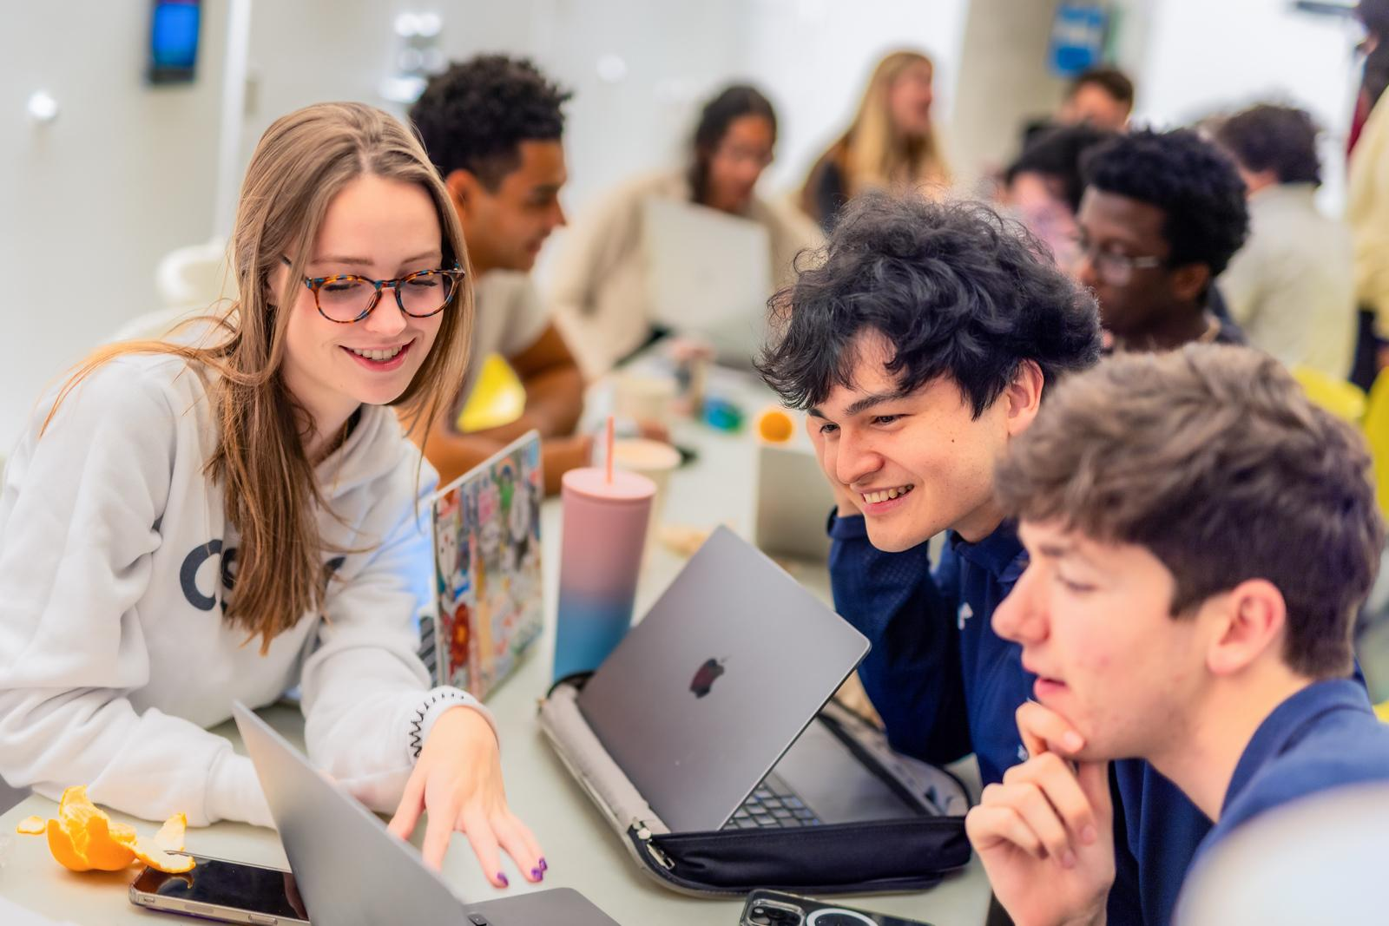

Slide 28
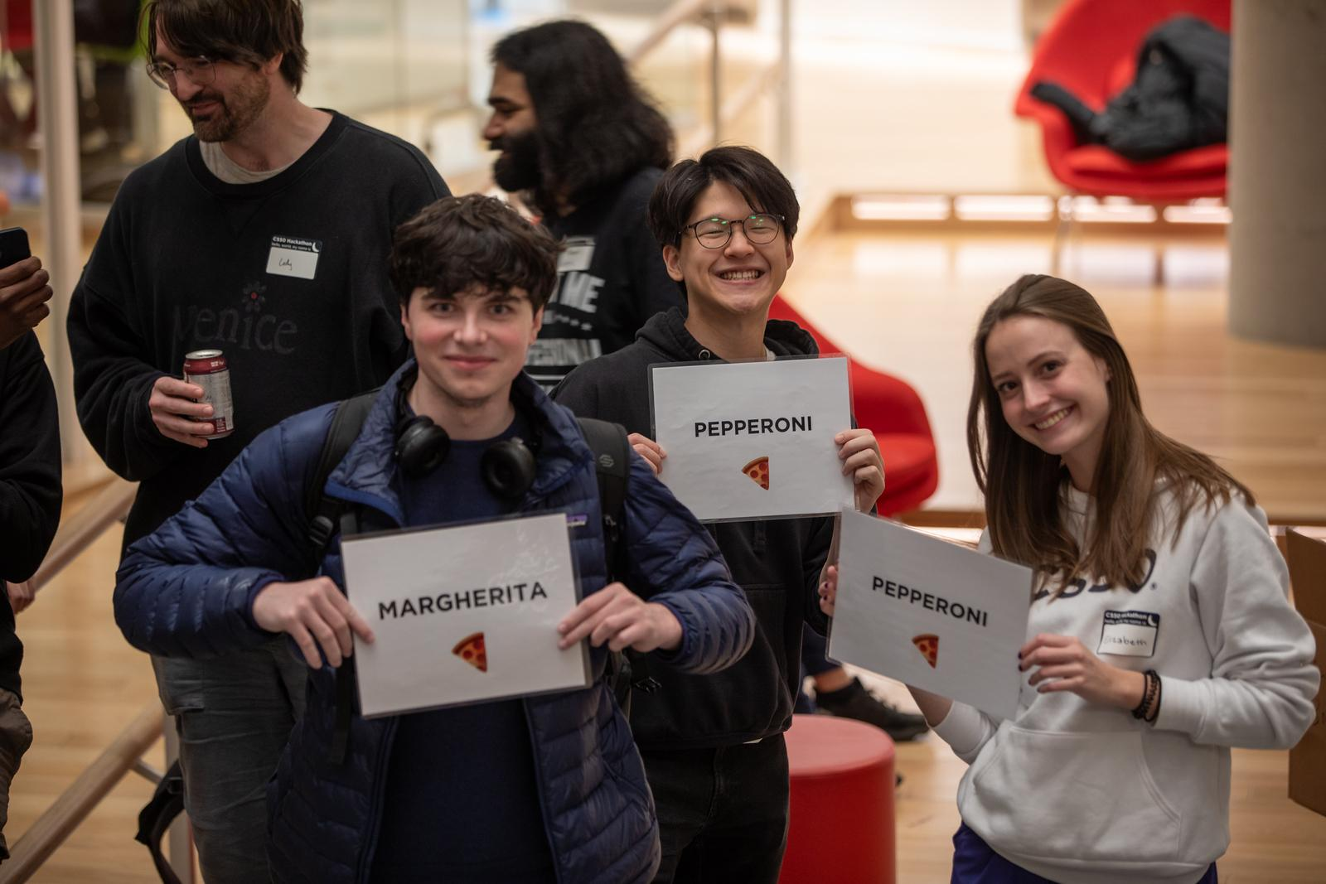

Slide 29
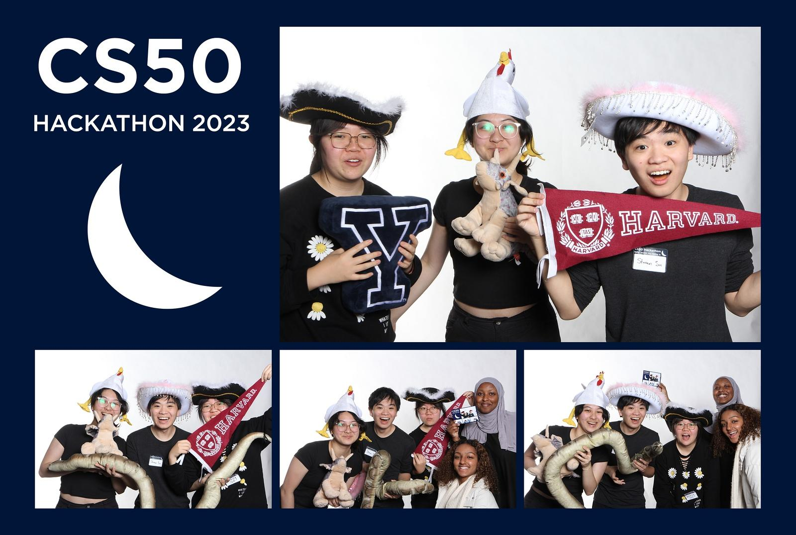

Slide 30
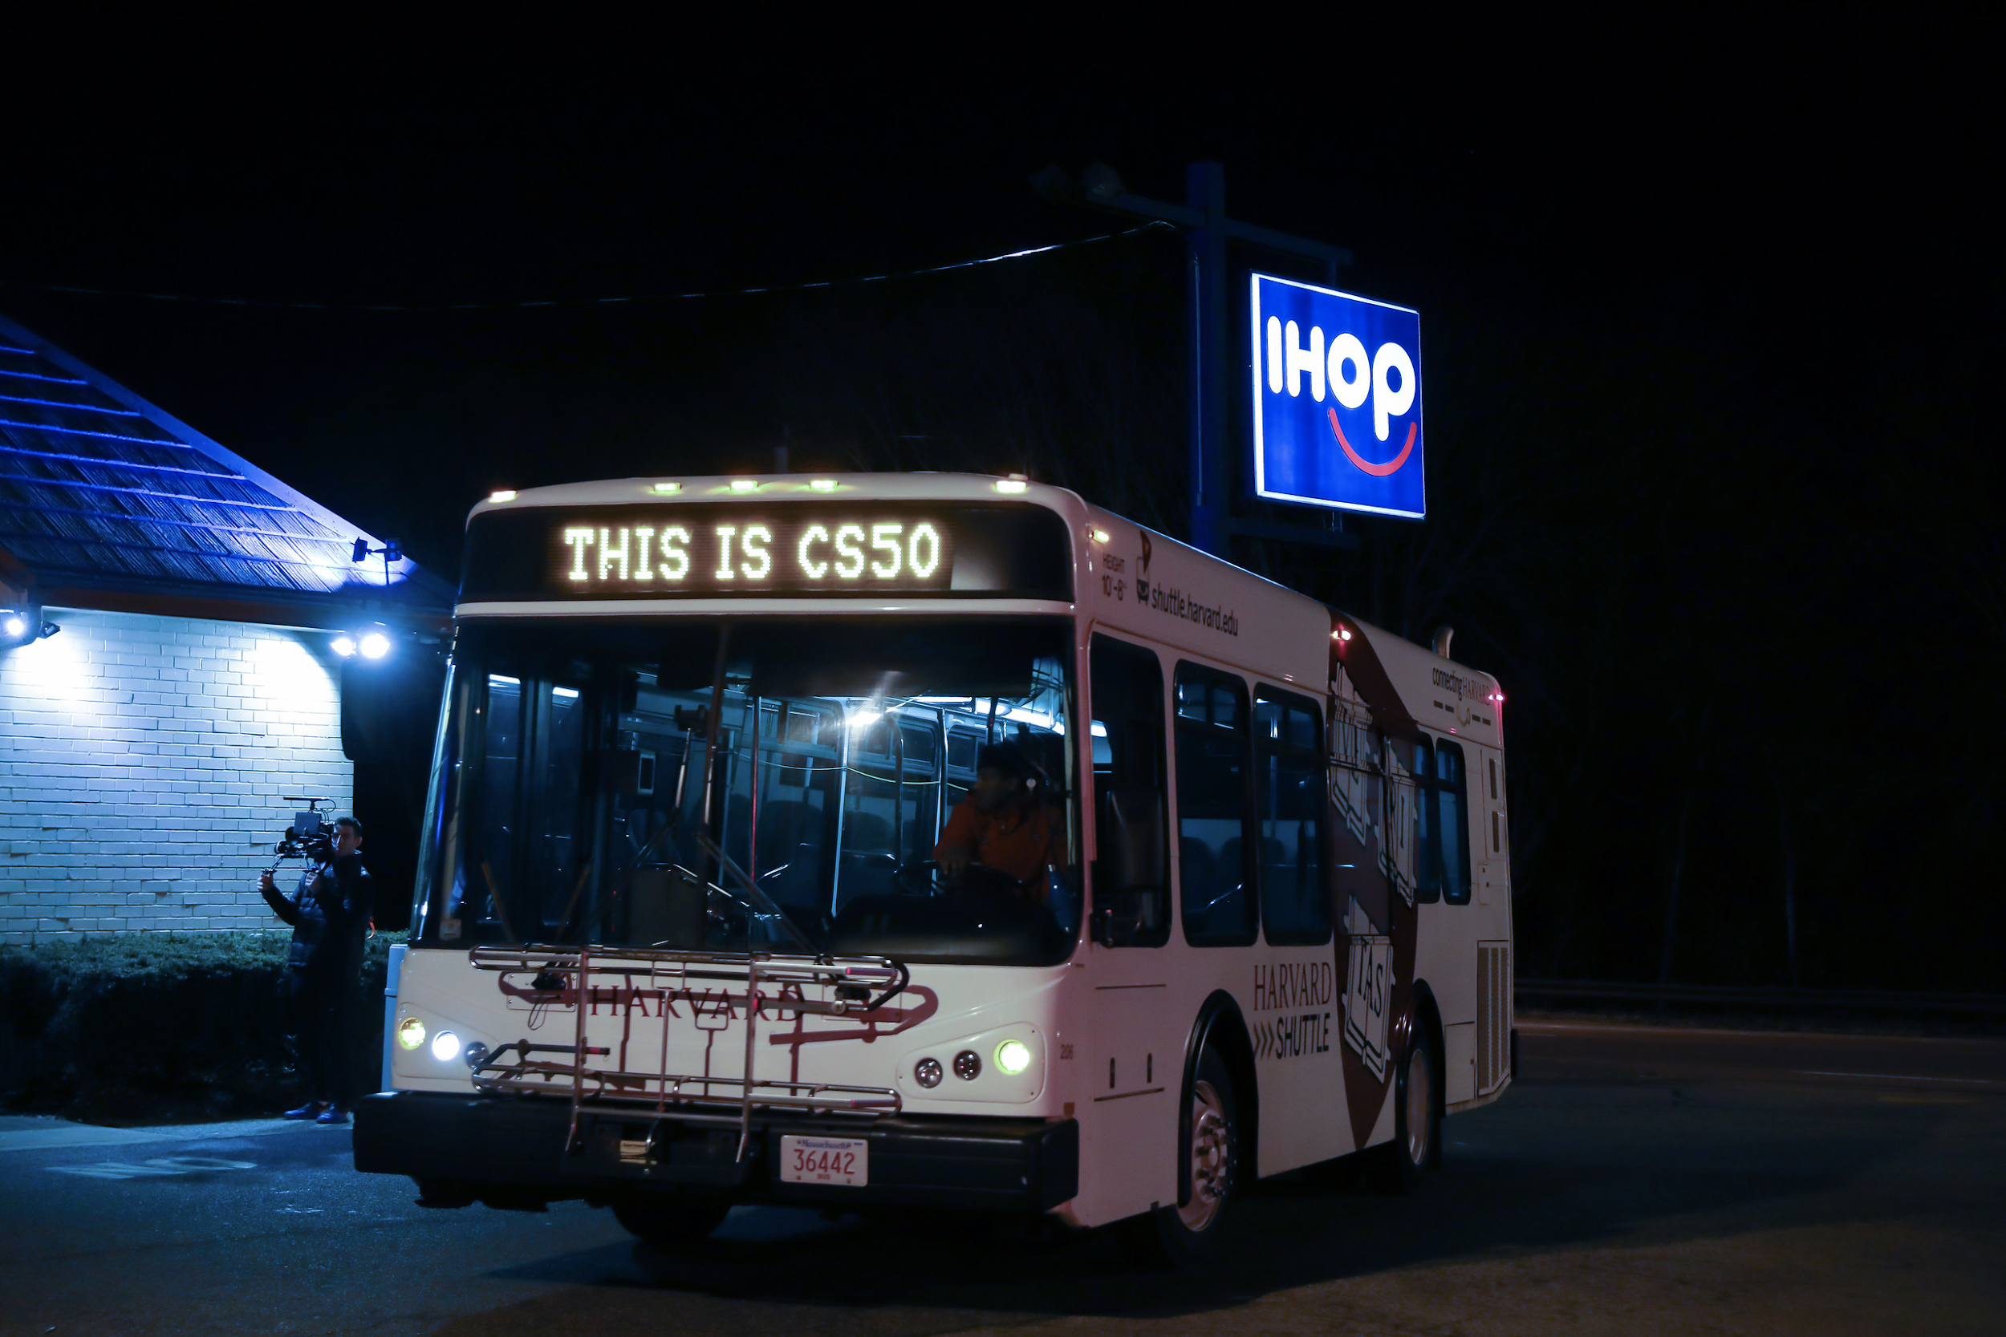

Slide 31
CS50 Fair

Slide 32


Slide 33
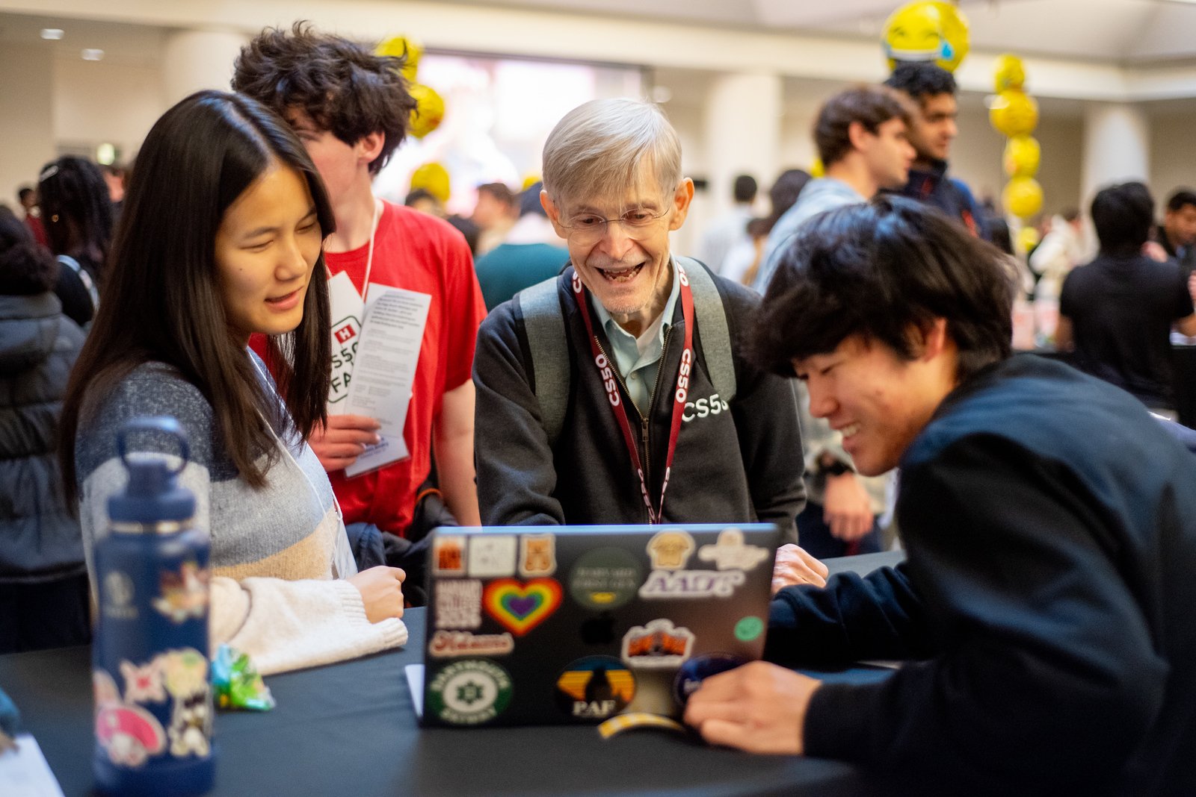

Slide 34
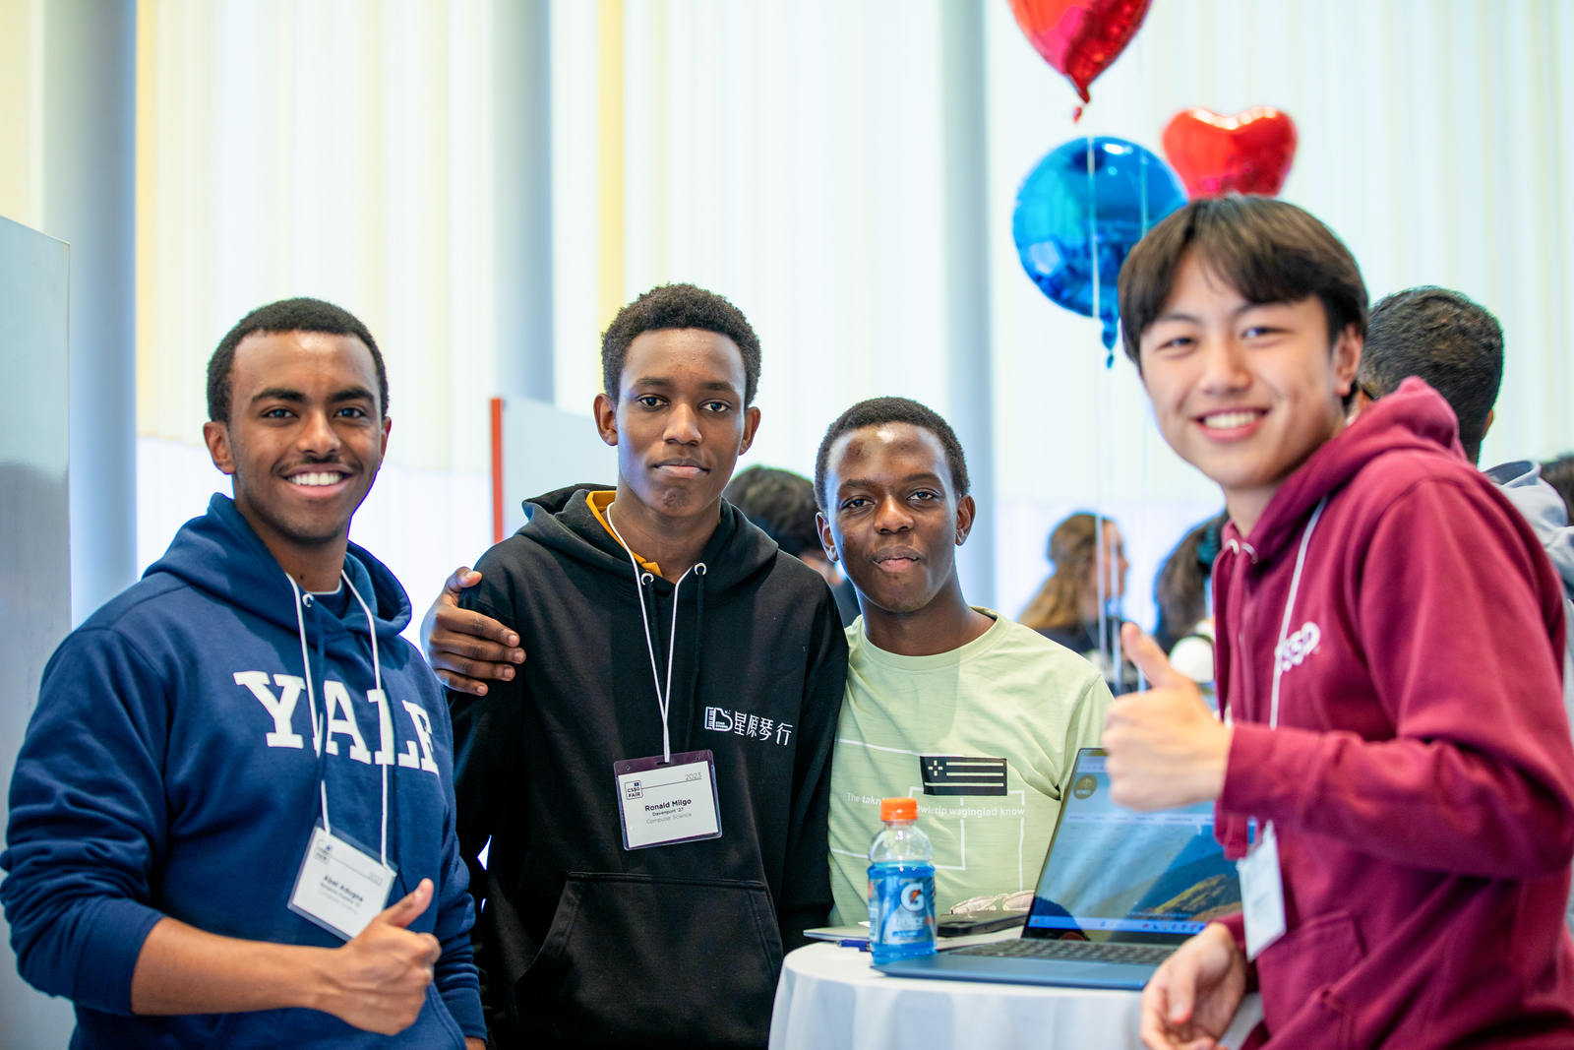

Slide 35
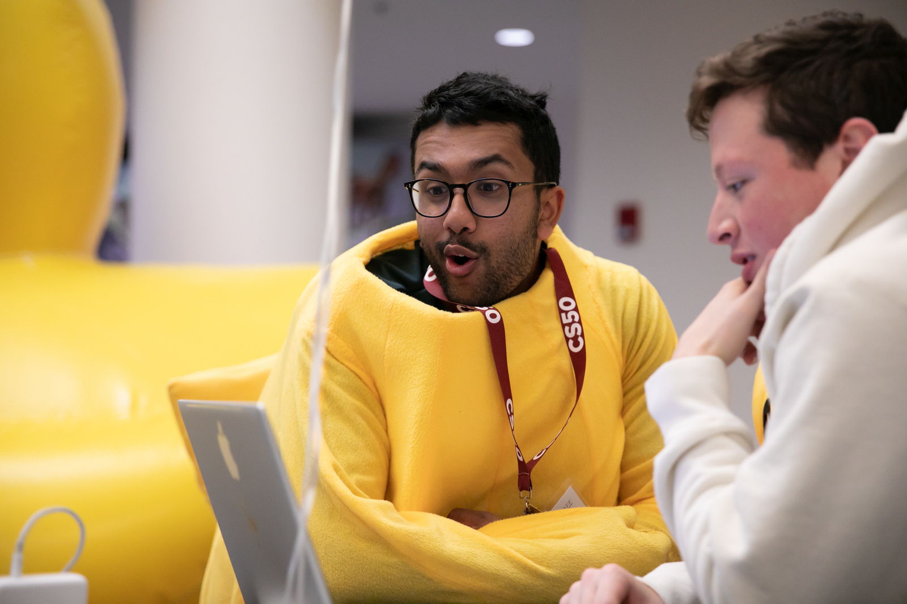

Slide 36
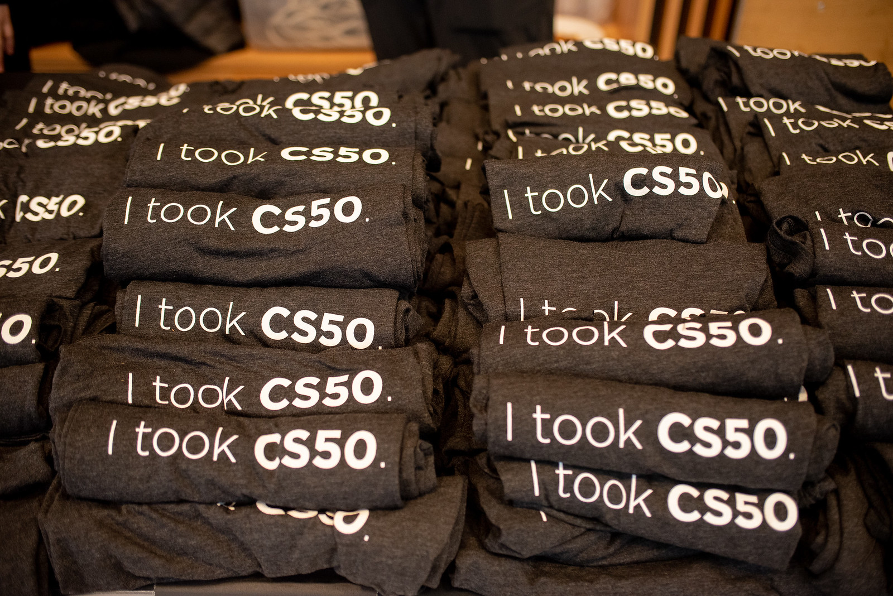

Slide 37
CS50 Charades 🎭

Slide 38
Visual Studio Code for CS50
cs50.dev

Slide 39
Visual Studio Code for CS50
code.visualstudio.com

Slide 40
Visual Studio Code for CS50
code.visualstudio.com
cs50.readthedocs.io/cs50.dev

Slide 41
Install command-line tools
https://developer.apple.com/xcode/ https://learn.microsoft.com/en-us/windows/wsl/about ...

Slide 42
Learn Git
https://youtu.be/MJUJ4wbFm_A ...

Slide 43
Host a website
https://pages.github.com/ https://www.netlify.com/ ...

Slide 44
Host a web app
https://aws.amazon.com/education/awseducate/ https://azure.microsoft.com/en-us/free/students/ https://cloud.google.com/edu/students https://education.github.com/pack https://www.heroku.com/ https://vercel.com/ ...

Slide 45
Ask questions
https://chatgpt.com/ https://github.com/features/copilot ...

Slide 46
Ask questions
https://www.reddit.com/r/learnprogramming/ https://www.reddit.com/r/programming/ https://stackoverflow.com/ https://serverfault.com/ …

Slide 47
Read news
https://techcrunch.com/ https://news.ycombinator.com/ ...

Slide 48
Take classes
https://cs50.edx.org/python https://cs50.edx.org/r https://cs50.edx.org/web https://cs50.edx.org/games https://cs50.edx.org/ai https://cs50.edx.org/sql https://cs50.edx.org/cybersecurity …

Slide 49
CS50P
Functions, Variables
Conditionals
Loops
Exceptions
Libraries
Unit Tests
File I/O
Regular Expressions
Object-Oriented Programming
Et Cetera

Slide 50
CS50R
Representing Data
Transforming Data
Applying Functions
Tidying Data
Visualizing Data
Testing Programs
Packaging Programs

Slide 51
CS50W
HTML, CSS
Git
Python
Django
SQL, Models, and Migrations
JavaScript
User Interfaces
Testing, CI/CD
Scalability and Security

Slide 52
CS50G
Pong
Flappy Bird
Breakout
Match 3
Super Mario Bros.
Legend of Zelda
Angry Birds
Pokémon
Helicopter Game 3D
Dreadhalls
Portal
Portal Problems

Slide 53
CS50 AI
Search
Knowledge
Uncertainty
Optimization
Learning
Neural Networks
Language

Slide 54
CS50 SQL
Querying
Relating
Designing
Writing
Viewing
Optimizing
Scaling

Slide 55
CS50 Cybersecurity
Securing Accounts
Securing Data
Securing Systems
Securing Software
Preserving Privacy

Slide 56
Apply

Slide 57
Stay in touch
cs50.harvard.edu/communities

Slide 58
Thank you

Slide 59


Slide 60


Slide 61


Slide 62


Slide 63
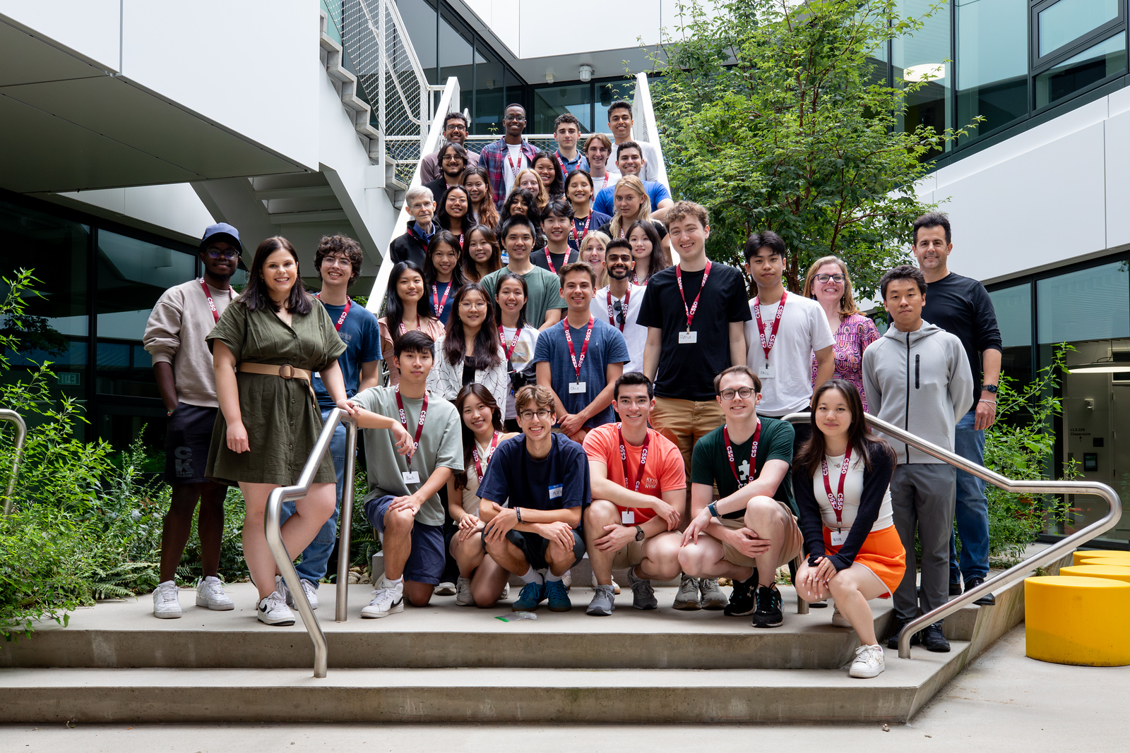

Slide 64
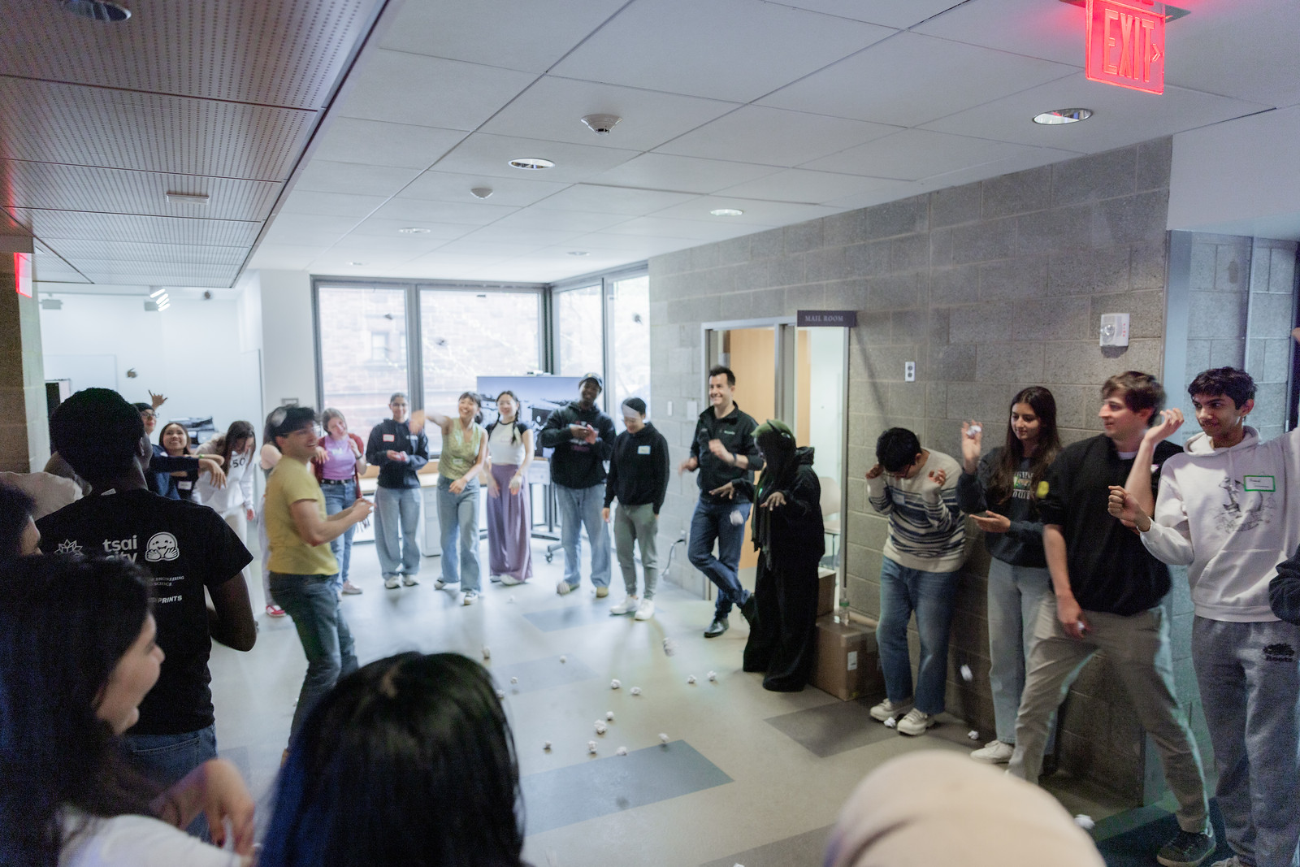

Slide 65
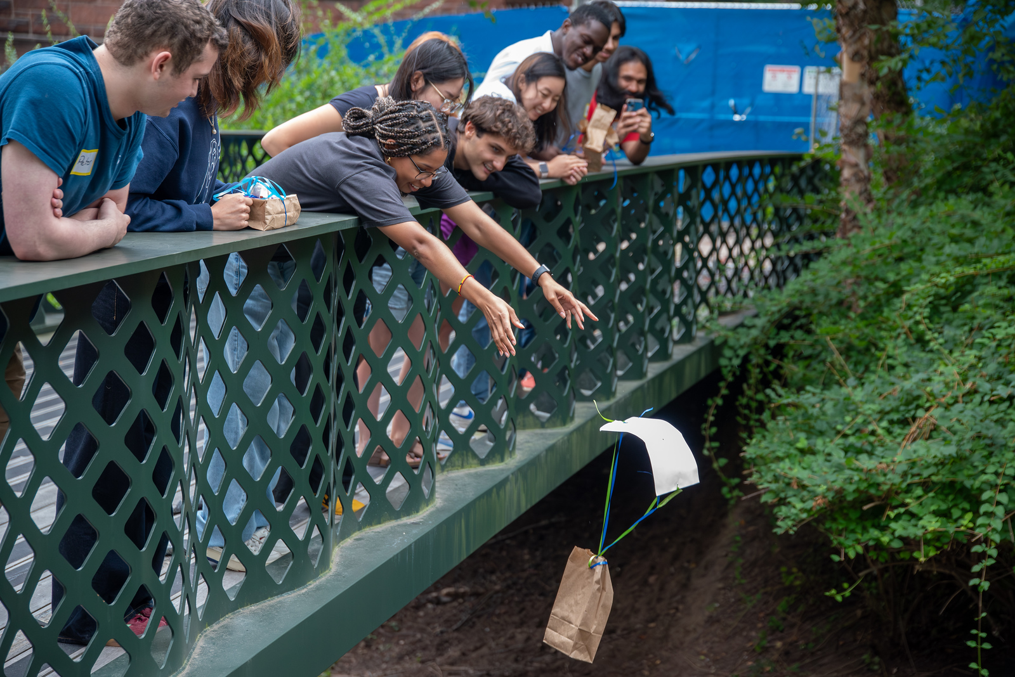

Slide 67
CS50 Quiz Show 🏆

Slide 68
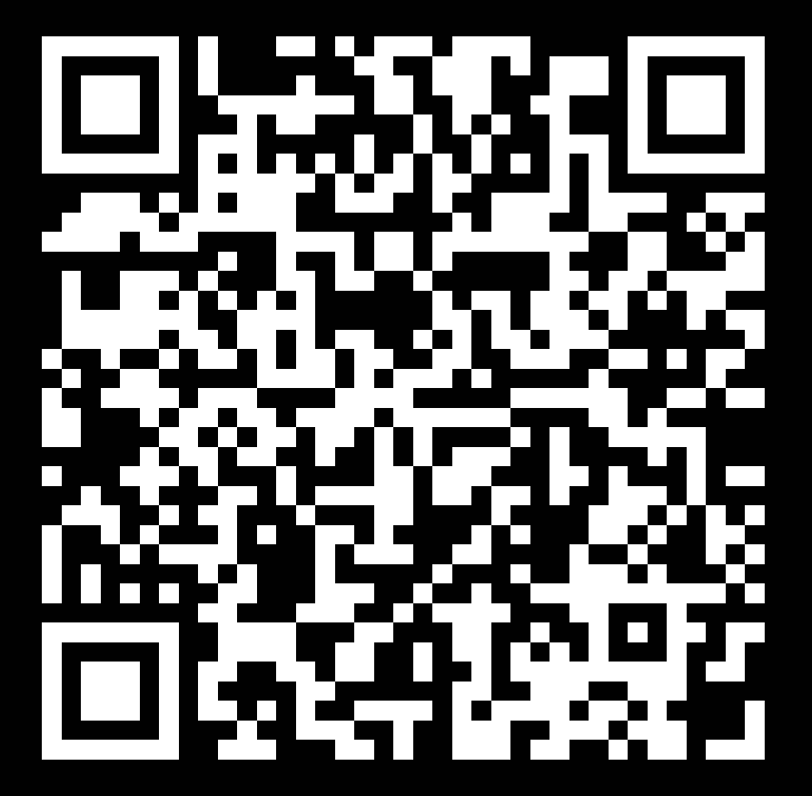

cs50.ly/poll
Notes:
https://emojipedia.org/apple/ios-17.4/selfie

Slide 69
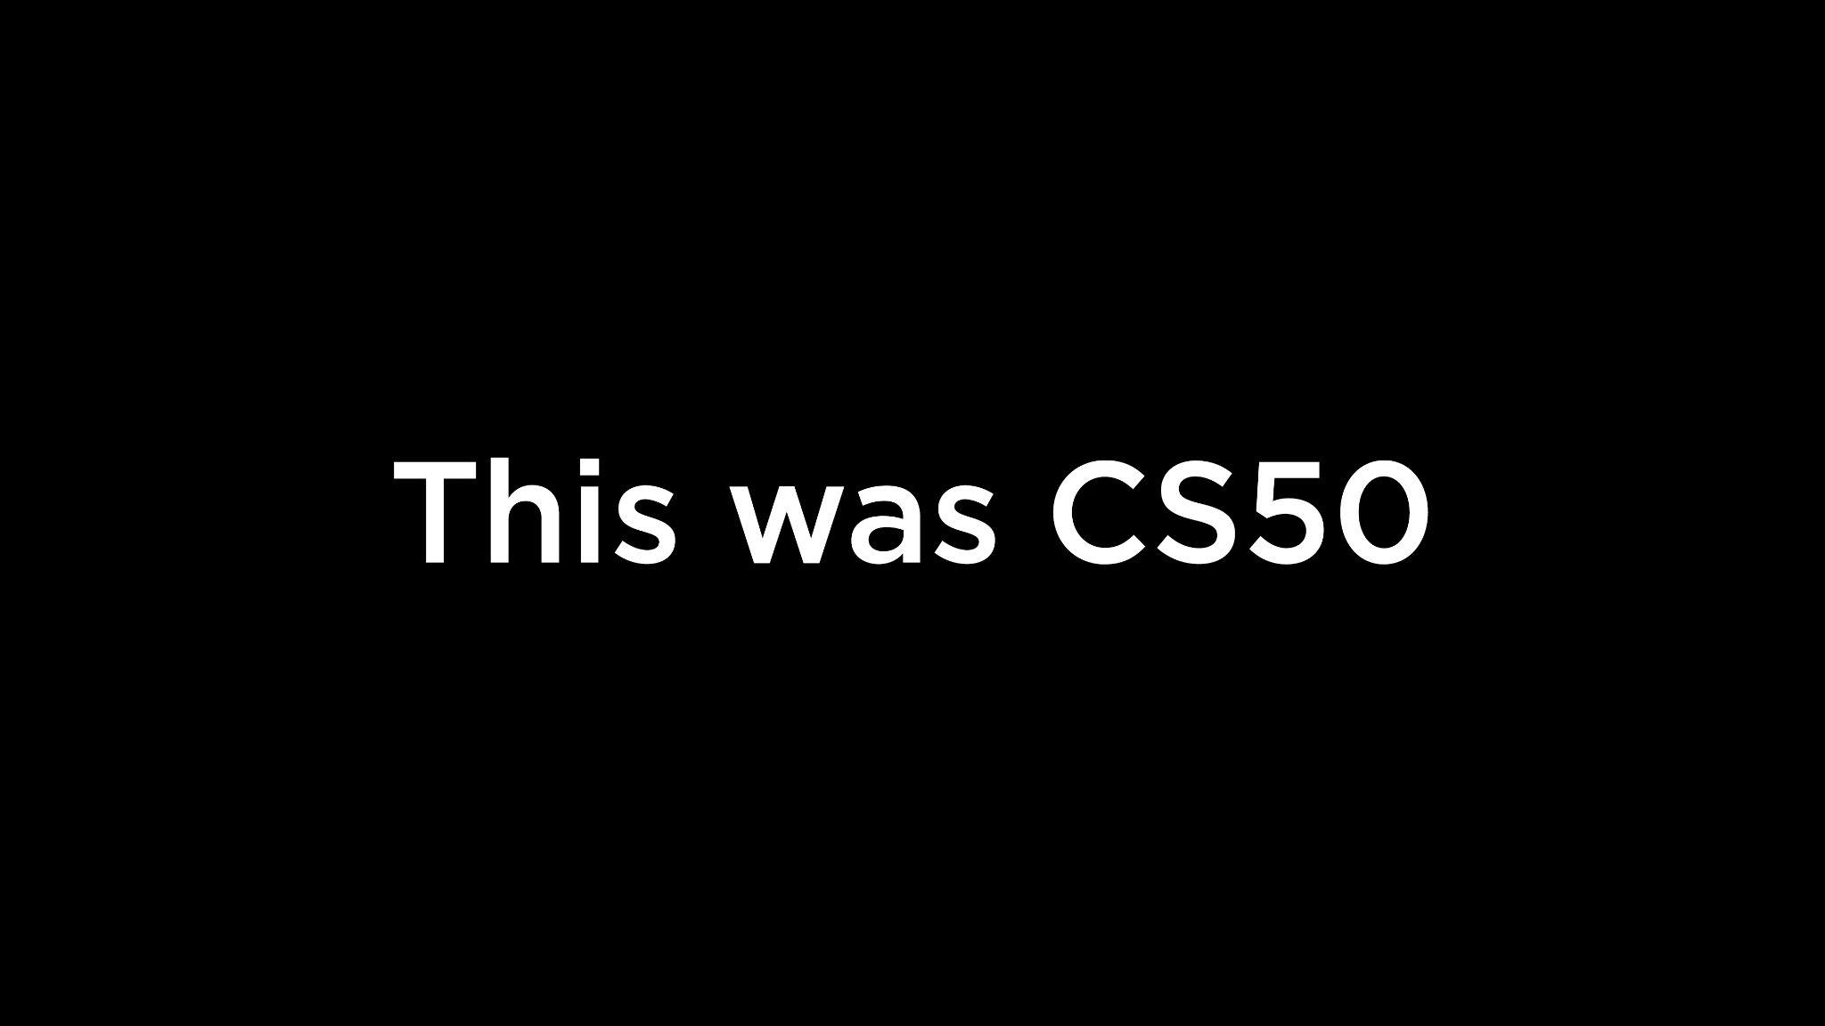

Slide 70
Notes:
https://emojipedia.org/cupcake/

